Slide 1

Notes:
SO/Before we start…..

Slide 2

Notes:
Before Moving on

Slide 3
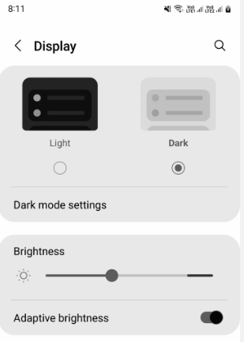
Do you know how the Auto Brightness feature of our smartphones work ?

Slide 4


Slide 5
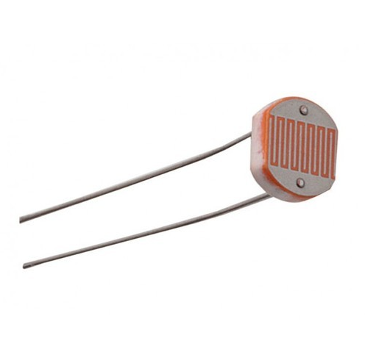
The smartphones have a hidden LDR sensor near the front camera which detects the ambient light and changes screen brightness accordingly.

Slide 6


Slide 7
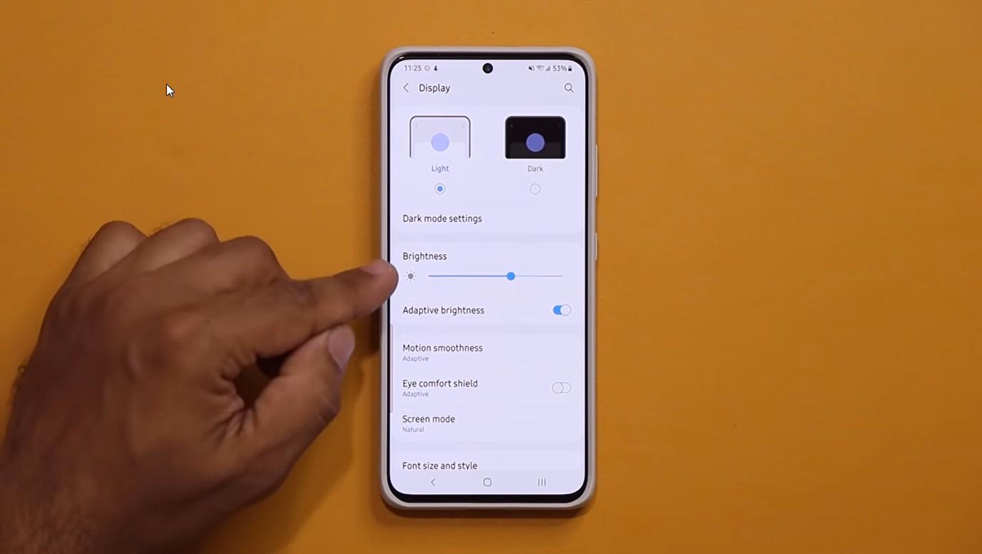

Slide 8
SO LET’S UNDERSTAND A LDR SENSOR CLOSELY

Slide 9


Slide 10


Slide 11
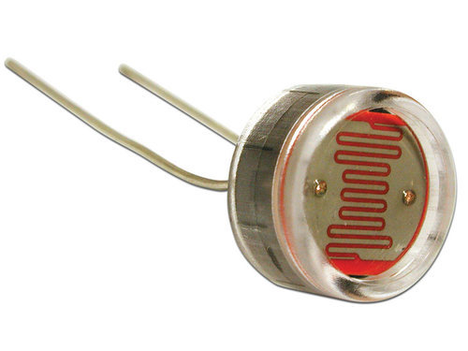
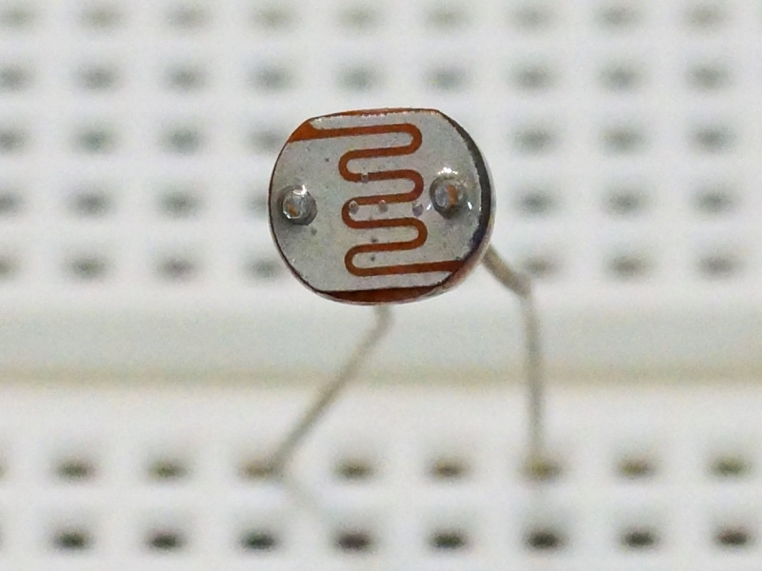
Light Dependent Resistor
Notes:
Let us see the working….

Slide 12
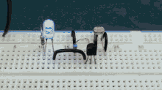
WORKING
LDR (Light Dependent Resistor) as the name states is a special type of resistor that works on the photoconductivity principle means that resistance changes according to the intensity of light.
Notes:
When I say about conductors insulators blah blah blah

Slide 13
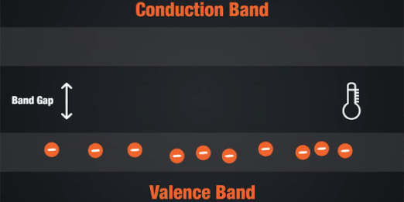

Semiconductors are the materials which have a conductivity between conductors (generally metals) and non-conductors or insulators (such as ceramics). Semiconductors can be compounds such as gallium arsenide or pure elements, such as germanium or silicon
Notes:
Valence Band
The energy band involving the energy levels of valence electrons is known as the valence band.
Conduction Band
It is the lowest unoccupied band that includes the energy levels of positive (holes) or negative (free electrons) charge carriers. It has conducting electrons resulting in the flow of current.

Slide 14
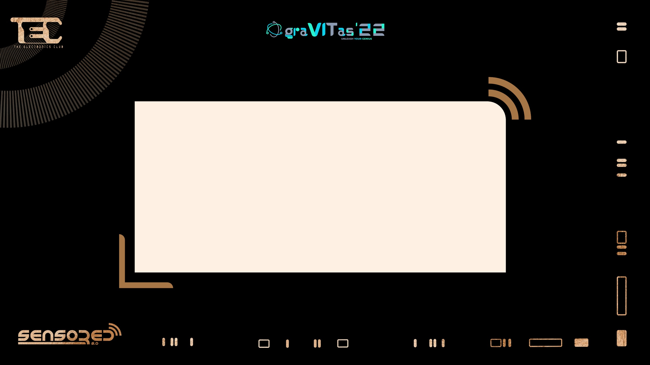
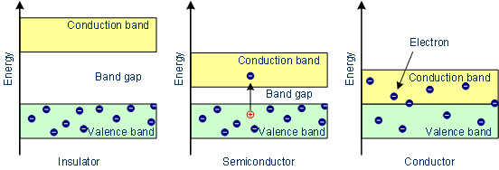

Slide 15
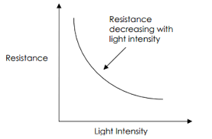
DEPENDANCY OF RESISTANCE ON :
INTENSITY OF LIGHT

Slide 16
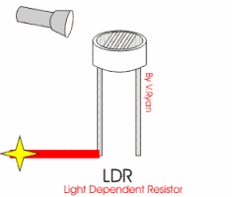

Slide 17
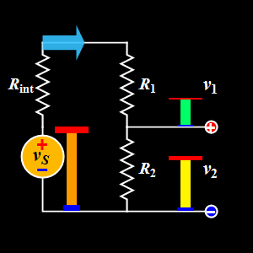
POTENTIAL DIVIDER

Slide 18
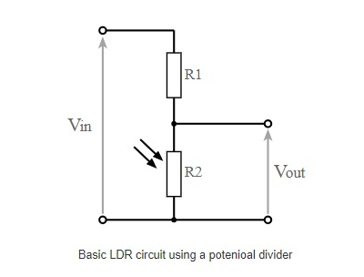

CIRCUIT

Slide 19
LDR (DEVICE SPECIFICATIONS)
PARAMETER | DETAILS
Peak wavelength | This photoresistor specification details the wavelength of maximum sensitivity.
Maximum operating voltage | The maximum operating voltage is observed, which is obtained at 0lux, which is darkness.
Resistance when illuminated | It is a key parameter for any photoresistor.
Dark resistance | Dark resistance values will be given for the photoresistor. Values are specified after a certain time as they have slow response.

Slide 20
1 candela is thus equal to 1 lumen per steradian. When a beam with a strength of 1 lumen falls on a surface of 1 square meter, this gives an illuminance of 1 lux. 1 lux is therefore equal to 1 lumen per square meter.

Slide 21
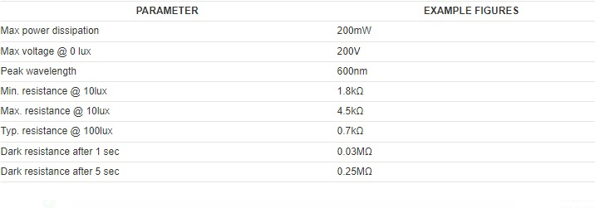
DEVICE SPECIFICATION

Slide 22


Slide 23

WHY LDR SENSOR ?

Slide 24
APPLICATIONS

Slide 25


Slide 26
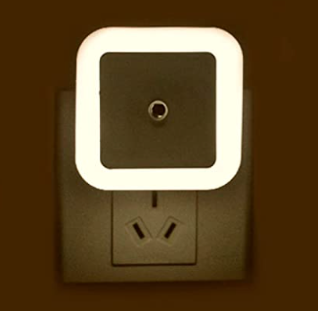
SMART LIGHTS

Slide 27
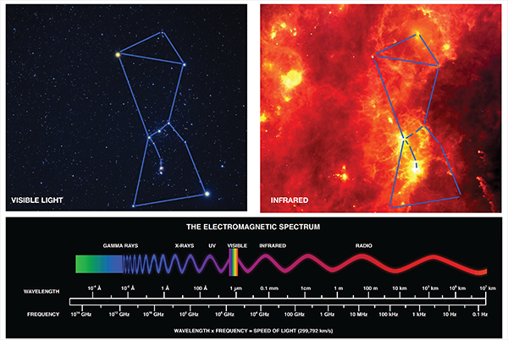
INFRARED ASTRONOMY
Notes:
Because LDR will generally observe very long wavelength far-infrared and sub- millimeter radiation, its huge diameter simply allows LDR to obtain as accurate a view at these wavelengths as SIRTF and optical telescopes achieve at near-infrared and optical wavelengths.

Slide 28
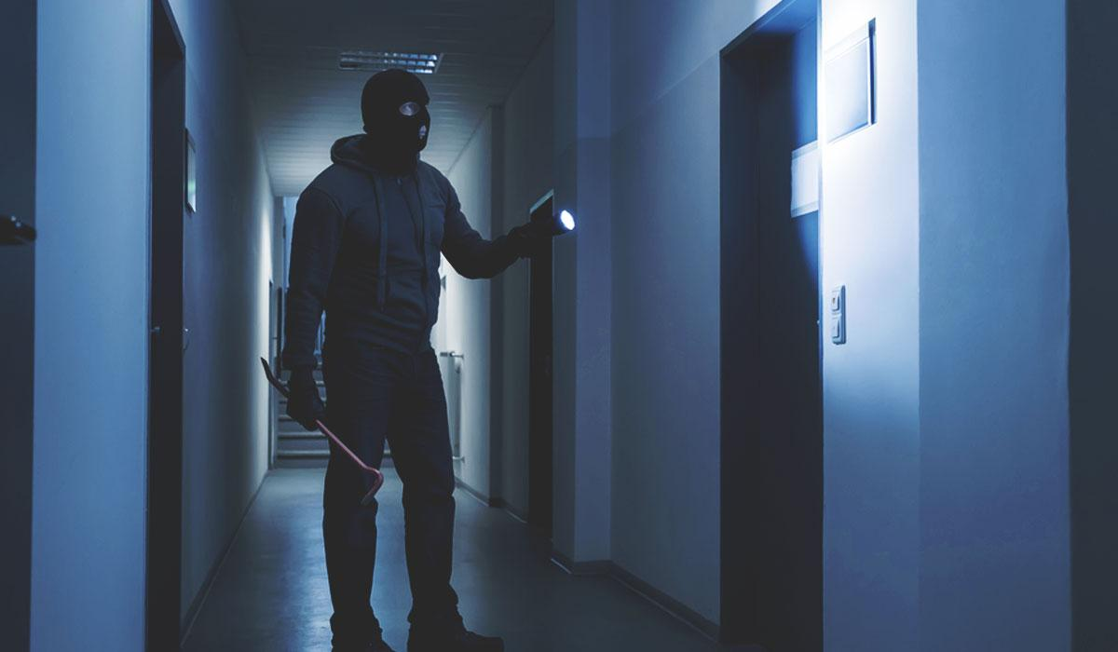
BURGLAR ALARM SYSTEM

Slide 29


Slide 30


IT’S PRACTICAL TIME NOW

Slide 31
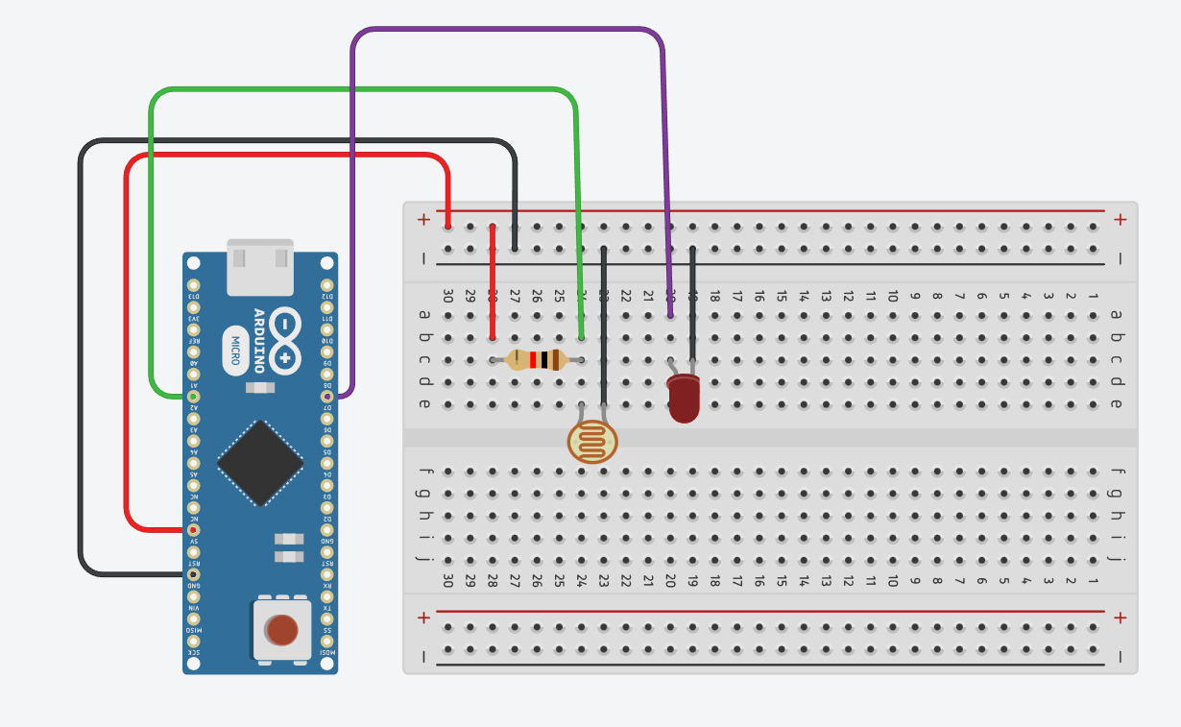
CIRCUIT DIAGRAM
DIGITAL PIN D5
ANALOG PIN
5V PIN
GROUND PIN

Slide 32
ARDUINO CODE :
void setup(){
Serial.begin(9600);
pinMode(5,INPUT);//to set input from the 5th digital pin
pinMode(A2,OUTPUT);//to set output to the A2 analog pin
}
void loop(){
if(analogRead(A2)<200){ //checking the output voltage on analog pin A2
Serial.println("Dark"); //print in the serial monitor
digitalWrite(5,HIGH);
}
else{
Serial.println(“Bright");
digitalWrite(5,LOW);
}
}

Slide 33

SPEAKERS : ARJUN RAIZADA AND ANINDYA DEY

